Slide 1
Sociology: 3549 CONFIDENCE INTERVAL
Recitation #8
Yue Chu

Slide 2
announcement
Homework #2 is due Oct. 23.
Remember to answer all questions.
Remember to show your work.

Slide 3
agenda
Review of lecture
Activity
Confidence interval
In class exercise
Upload your answer to Carmen for attendance

Slide 4
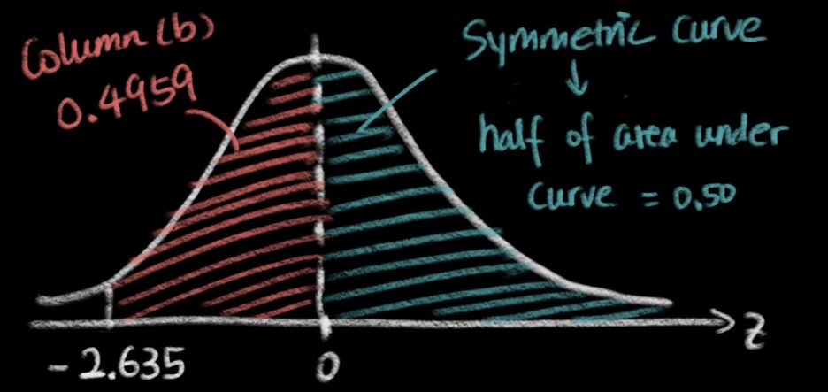

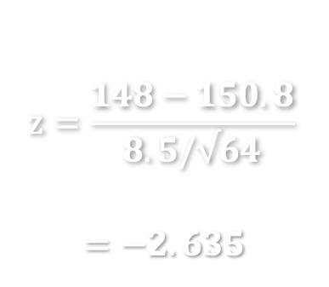
EXERCISE FROM LAST WEEK
GRE score mean = 150.8, SD = 8.5, n=64 students.
Q1: Distribution of sample mean: per CLT, mean=150.8, SE = 8.5$/√64$
Q2: Percentage of sample with mean score above 148.
Convert
Draw
Find
Calculate
$$z=\frac{148−150.8}{8.5/√64}$$
$$=−2.635$$
0.4959+0.5=0.9959
Interpretation:
99.59% of samples with size of 64 students has mean GRE verbal score above 148.

Slide 5
Statistical inference
Sample distribution
Empirical Directly measured Not of primary interest
Population distribution
Empirical Unknown Distribution of interest
How your sample would behave if you know the “true” distribution of your population.

Slide 6
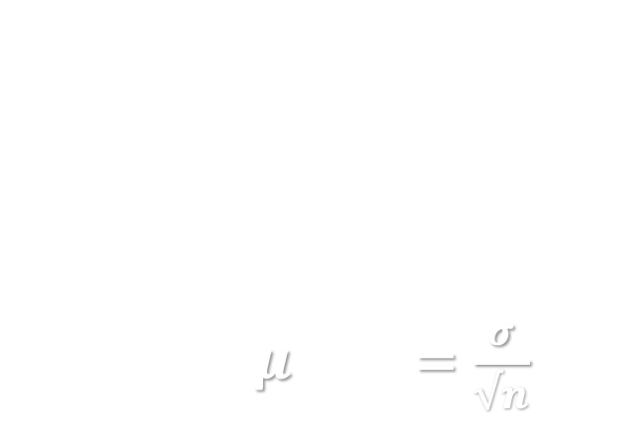
Central limit theorem
With sufficiently large sample size n, distribution of sample mean is normal distribution
mean= $μ$ , SE $=\frac{σ}{√n}$
What distribution of sample mean would be if knowing true pop distribution.
Single random sample with large n provides good estimate of true pop mean.

Slide 7
our ultimate goal
Sample distribution
Empirical Directly measured Not of primary interest
Population distribution
Empirical Unknown Distribution of interest
What do we know about the true population mean based on single random sample?

Slide 8
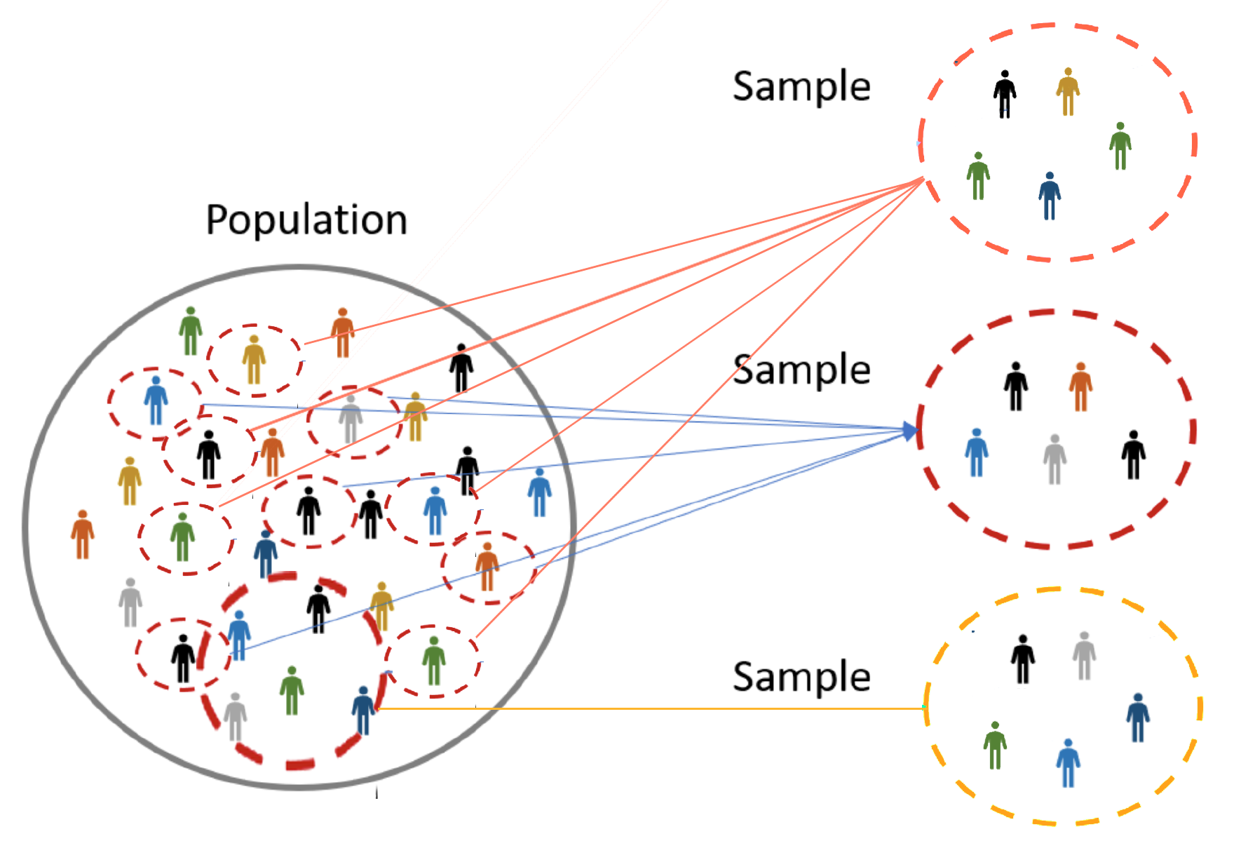


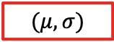
Point estimate and uncertainty
Sample mean for a single random sample ($\overline{x}$)
Point estimate
Close to $μ$, the true pop mean
but uncertain it would be the “truth”
Based on CLT
Estimate the range of sample means that the true population mean would mostly likely fall into.
$$(μ, σ)$$
Notes:
Point estimate: one single value directly from the sample

Slide 9

Confidence Interval
Specify the probability that the true population mean (μ) falls within a range of sample means ($\overline{x}$)
Allows us to specify level of certainty in estimating population characteristics from sample data

Slide 10

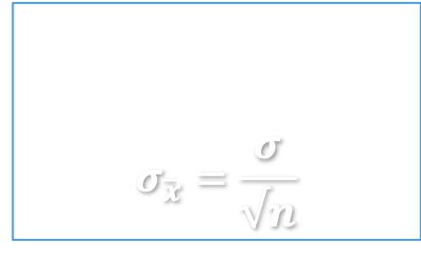
Calculation of Confidence Interval
Number of SD units between lower and upper limit of CI.
(Self-defined)
$$\overline{x}±z∙σ_{\overline{x}}$$
Sample mean
Standard error
$$σ_{\overline{x}}=\frac{σ}{√n}$$
Margin of error
Interpretation
Based on our sample of size n, we are XX% confident that the true population mean is somewhere between <lower limit> and <upper limit>.
Notes:
Confidence interval = estimate + margin of error
Lower limit: estimate – margin of error
Upper limit: estimate + margin of error
In plain English, the confidence interval says, we can be x% confident that values fall within a certain range.

Slide 11
Interpretation of Confidence Interval
Most commonly used z = 1.96, corresponding to 95% CI
Notes:
What does 95%CI mean:
If you construct 95%CI based on sample mean of one random sample of size n from the population, 95% of chance that your 95%CI will cover true mean.
If you construct 95%CI for repeatedly drawn random samples of size n from the population, 95% of them will capture/cover true mean.

Slide 12
Parameters affecting Confidence Interval
What happens to the range of confidence intervals when we want to be more confident? (say from 90% to 95% to 99% confident)?
What happens to the range of a confidence interval if we have larger sample size?
Notes:
If want to speak with higher confidence, i.e. 99% v 95%, then the confidence interval will get wider.

Slide 13


Interpretation of Confidence Interval
Higher confidence level, wider CI.
$$\overline{x}±z∙σ_{\overline{x}}$$
Standard error
$$σ_{\overline{x}}=\frac{σ}{√n}$$
Larger sample size, narrower CI.
Notes:
Confidence interval = estimate + margin of error
Lower limit: estimate – margin of error
Upper limit: estimate + margin of error
In plain English, the confidence interval says, we can be x% confident that values fall within a certain range.

Slide 14
Confidence vs precision

Slide 15

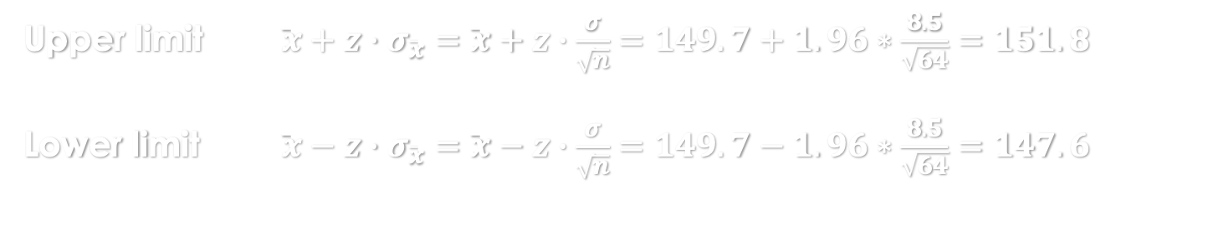

EXAMPLE – calculate CI given $σ$
GRE verbal test score has SD = 8.5. You took a sample of n=64 students, and calculated their mean score $\overline{x}$=149.7
Question: what is the interval which we are 95% confident that the true population mean would fall into?
Half of 0.95 is 0.475, corresponding to z score: $z=1.96$
Find
Calculate
Interpret
Upper limit $\overline{x}+z∙σ_{\overline{x}}=\overline{x}+z∙\frac{σ}{\sqrt{n}}=149.7+1.96∗\frac{8.5}{\sqrt{64}}=151.8$
Lower limit $\overline{x}−z∙σ_{\overline{x}}=\overline{x}−z∙\frac{σ}{\sqrt{n}}=149.7−1.96∗\frac{8.5}{\sqrt{64}}=147.6$
Based on our sample of 64 students, we are 95% confident that average GRE score for all students falls between 147.6 and 151.8.

Slide 16
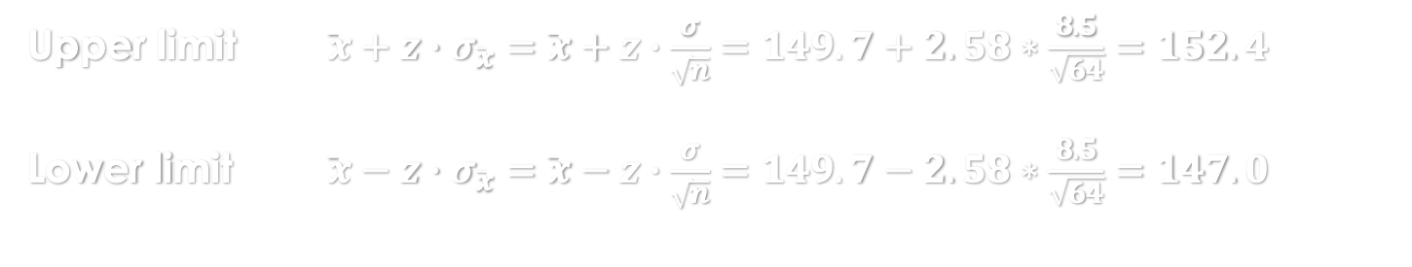

EXAMPLE – calculate CI given $σ$
GRE verbal test score has SD = 8.5. You took a sample of n=64 students, and calculated their mean score $\overline{x}$=149.7
Question: what is the interval which we are 99% confident that the true population mean would fall into?
Half of 0.99 is 0.495, corresponding to z score: $z=2.58$
Find
Calculate
Interpret
Upper limit $\overline{x}+z∙σ_{\overline{x}}=\overline{x}+z∙\frac{σ}{\sqrt{n}}=149.7+2.58∗\frac{8.5}{\sqrt{64}}=152.4$
Lower limit $\overline{x}−z∙σ_{\overline{x}}=\overline{x}−z∙\frac{σ}{\sqrt{n}}=149.7−2.58∗\frac{8.5}{\sqrt{64}}=147.0$
Based on our sample of 64 students, we are 99% confident that average GRE score for all students falls between 147.0 and 152.4.

Slide 17
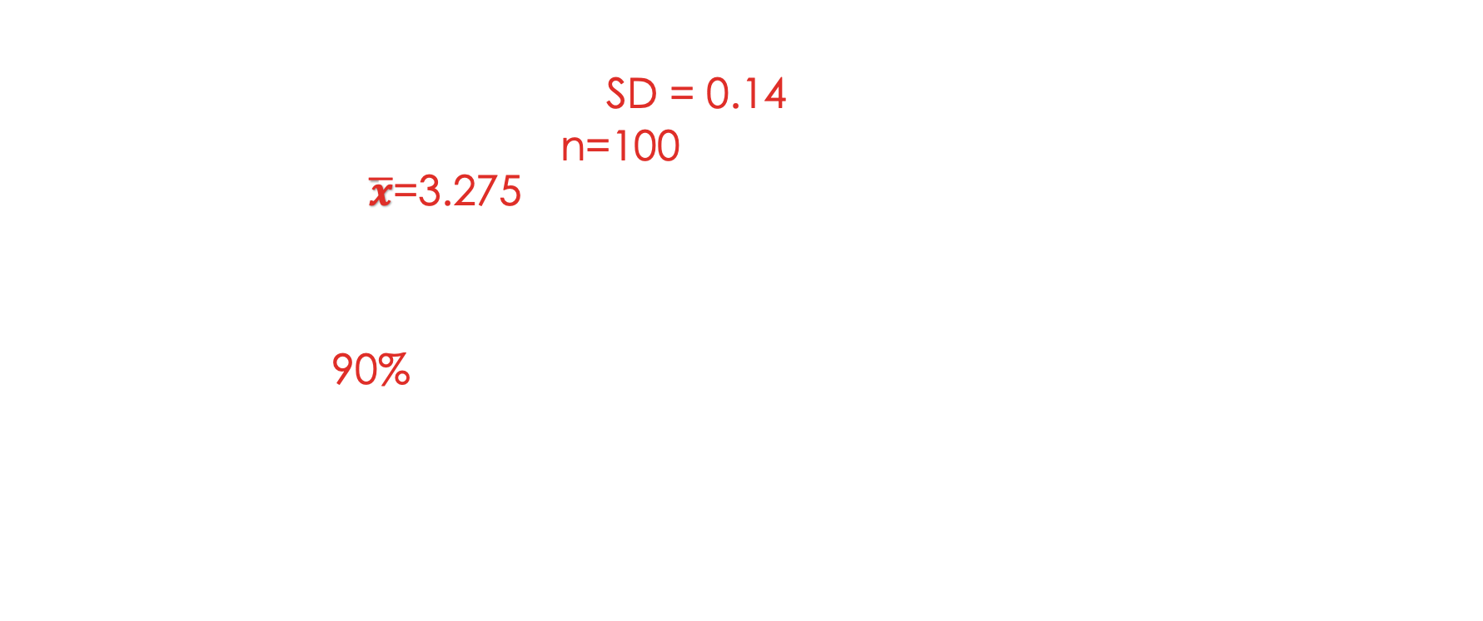
In-class exercise
Birth weight example
US girls has birth weight: SD = 0.14
You took a sample of n=100 newborns, and calculated their mean birth weight $\overline{x}$=3.275
Question
Calculate 90% confident interval.
Write one or two sentence to interpretation your result.
Type your answer in Carmen – Lab attendance
Notes:
3.275 + 1.64 * 0.14/10 =
3.275 - 1.64 * 0.14/10 =

